Slide 1


Economic Growth and Development
An Introduction to Economic Principles

Slide 2
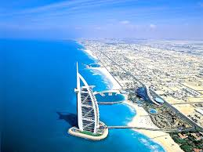
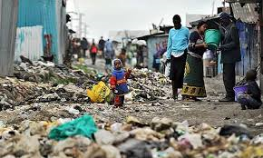
Thinking Questions:
Why are some countries wealthier than others?
Why is the standard of living higher in some countries than others?

Slide 3
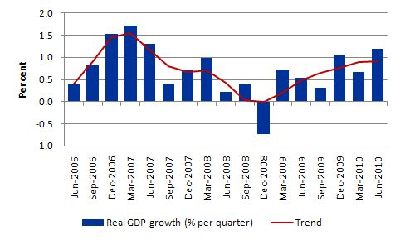
What is Economic Growth?
One of the most important goals of any economy is to grow every year. Economic growth can provide increased living standards for people.
Economic growth occurs when an economy produces more goods and services this year than it did last year. To produce more goods and services, a country must access extra natural, human and capital resources or use existing resources more effectively.
Economic growth can also occur with increased spending on locally made products by households, businesses and governments.

Slide 4

Measuring Economic Growth
GDP (Gross Domestic Product) is commonly used as an indicator of the economic health of a country, as well as a gauge of a country's standard of living. Since the mode of measuring GDP is uniform from country to country, GDP can be used to compare the productivity of various countries with a high degree of accuracy.

Slide 5

Measuring Economic Growth
A nation’s GDP from any period can be compared against previous years or quarters.
GDP is the total value of all goods and services produced across the nation in a given year.
Example: Australia produces goods and services totalling US$1,339.54 billion
In our example, Australia’s population is 23,130,000
Australia’s GDP per capita is $57,913.
GDP per Capita =
Annual GDP
Population

Slide 6


Your Task Economic Growth and Living Standards
Make notes on the following:-
The GDP and GDP per capita of your country.
What is it like to live in your country?
What effect might GDP have on living standards in your chosen country?
What kinds of things does your country produce?
ACTIVITY:
You will be given a country. Research their GDP.
http://www.tradingeconomics.com/australia/gdp-per-capita
vs.

